Slide 1


Computer Engineering

Slide 2
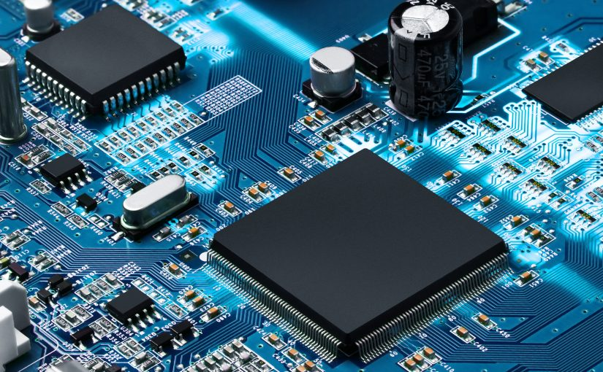


What is computer engineering?
Computer Engineers work at the border between Hardware & Software to create embedded systems that are used in everyday life
Write Software
Circuit Design
Embedded Systems

Slide 3
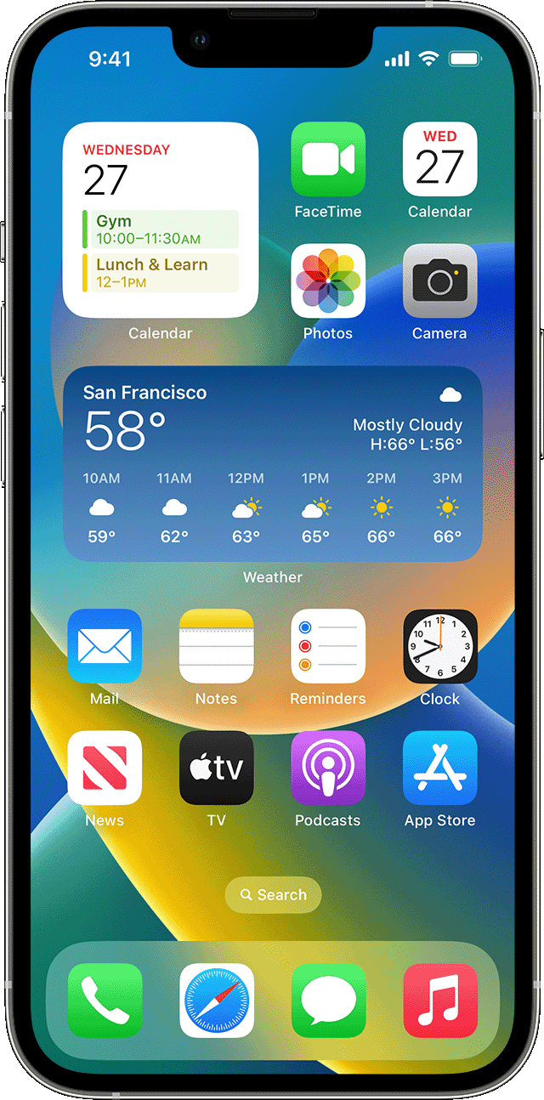
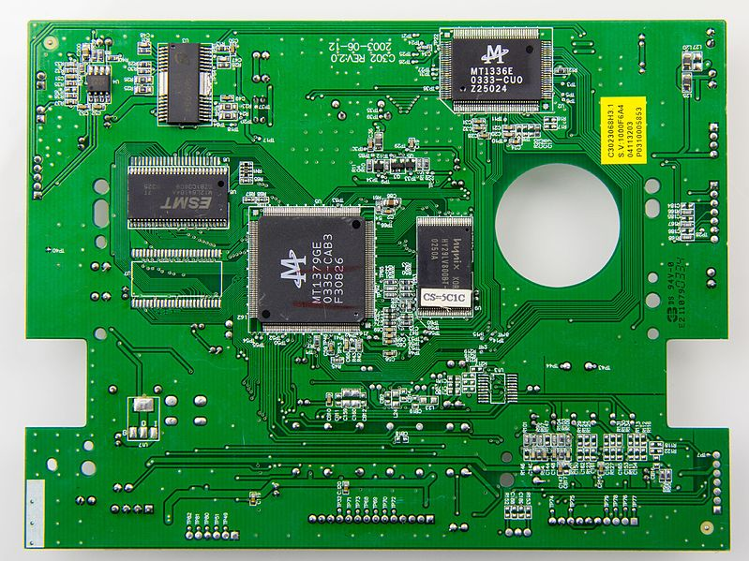

Hardware vs Software
Designed by Engineers and built in a factory
Hardware consists of the physical parts of a computer
Hardware is hard to change once it leaves the factory
Examples(Laptop, Cellphone, TV)
Software engineers write code that tells the computer what to do.
Code is compiled into software applications that can be loaded an many devices
Examples(Windows, IoS, Phone Apps)

Slide 4
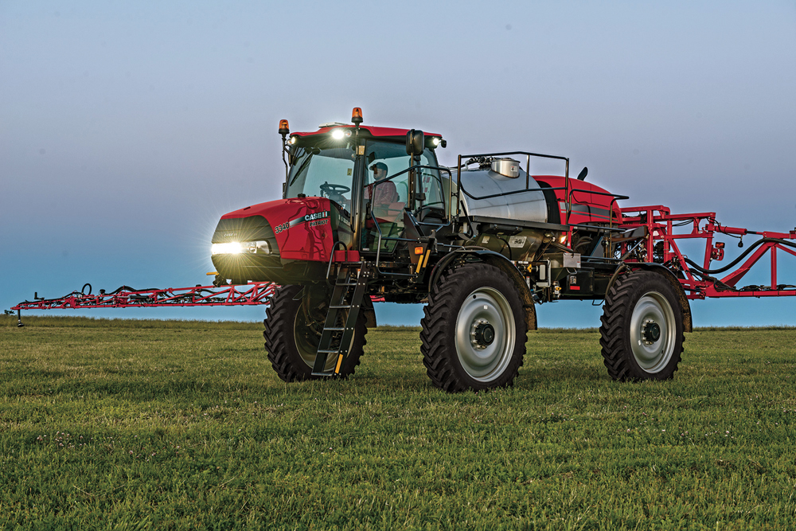
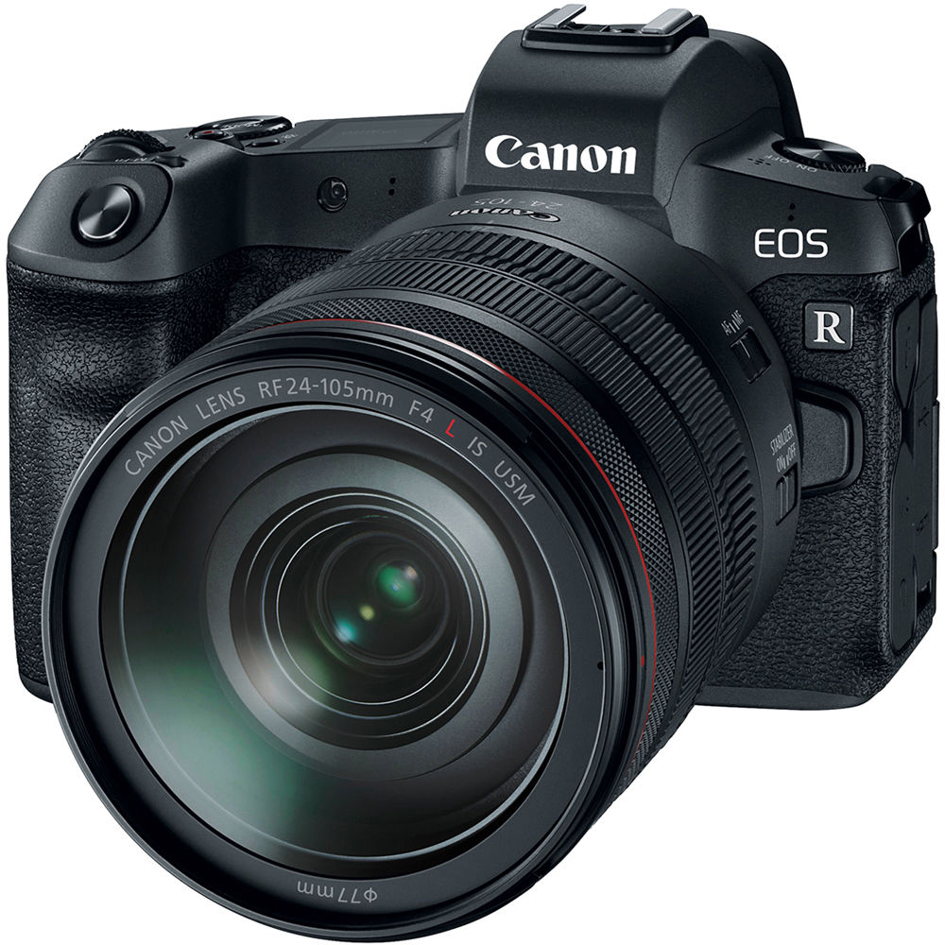
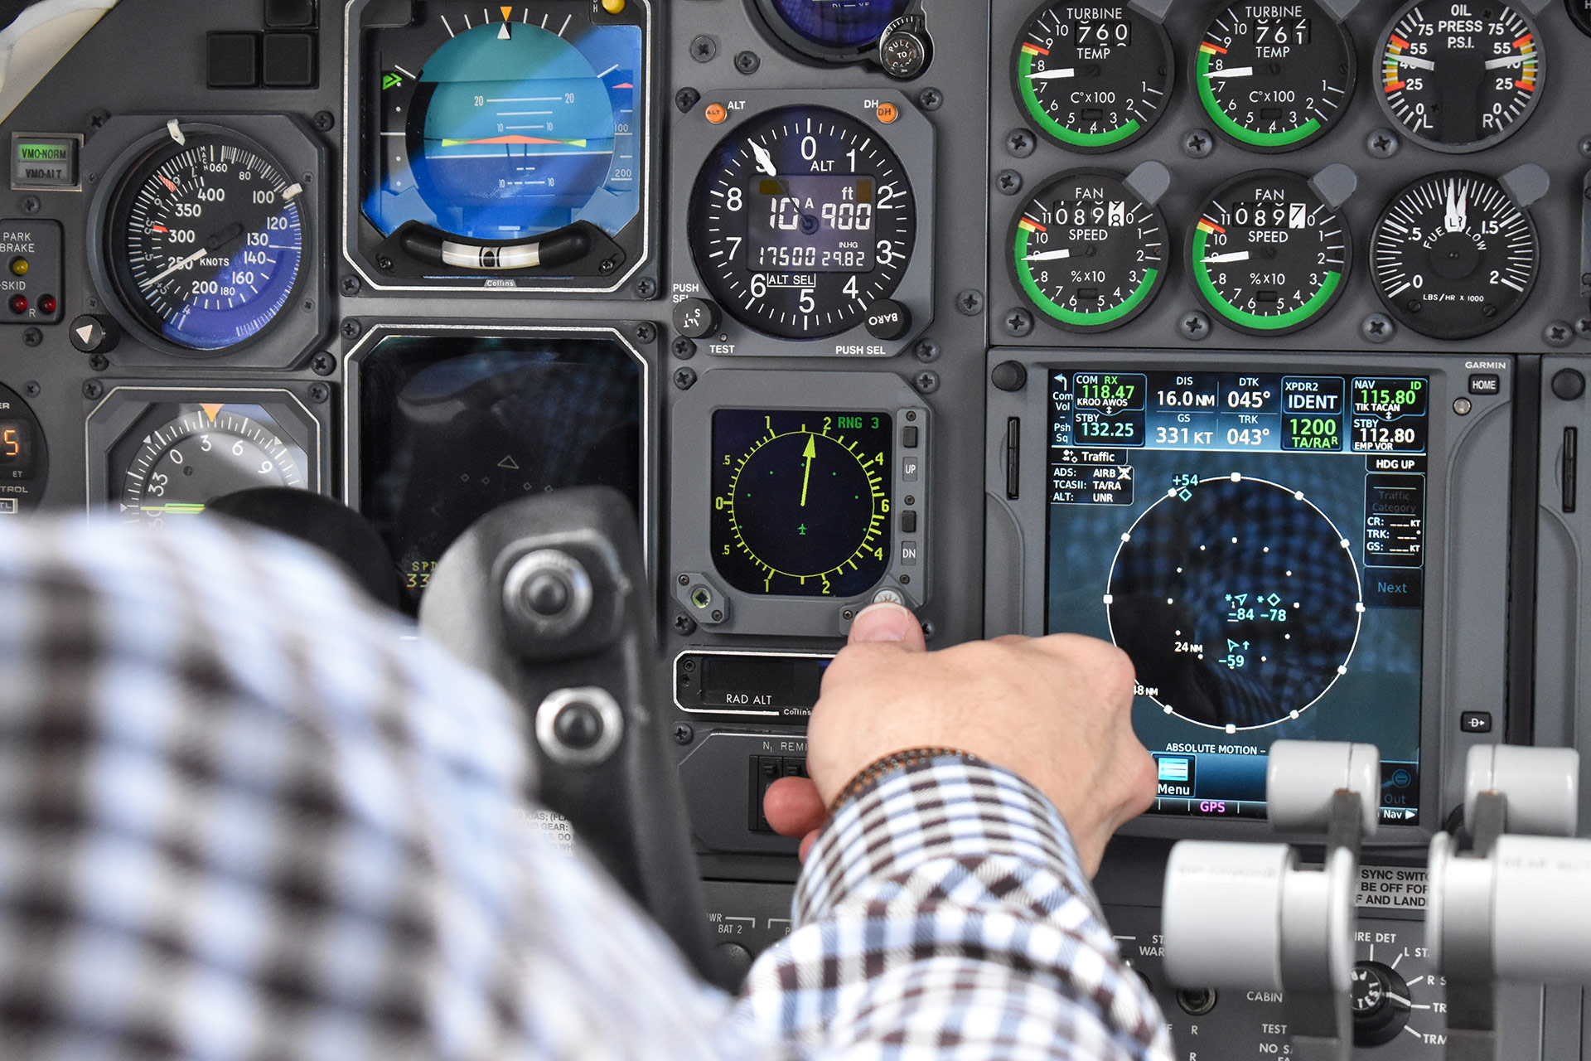
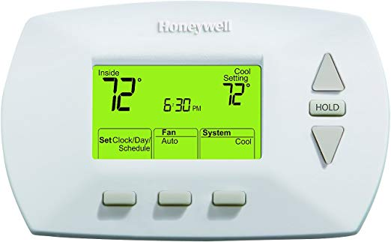
Embedded Software
A special type of computer software written to control machines or devices with very small amounts of computing power
Embedded software may have no user interface or OS
Embedded software may run on small components that are inside of larger computers

Slide 5
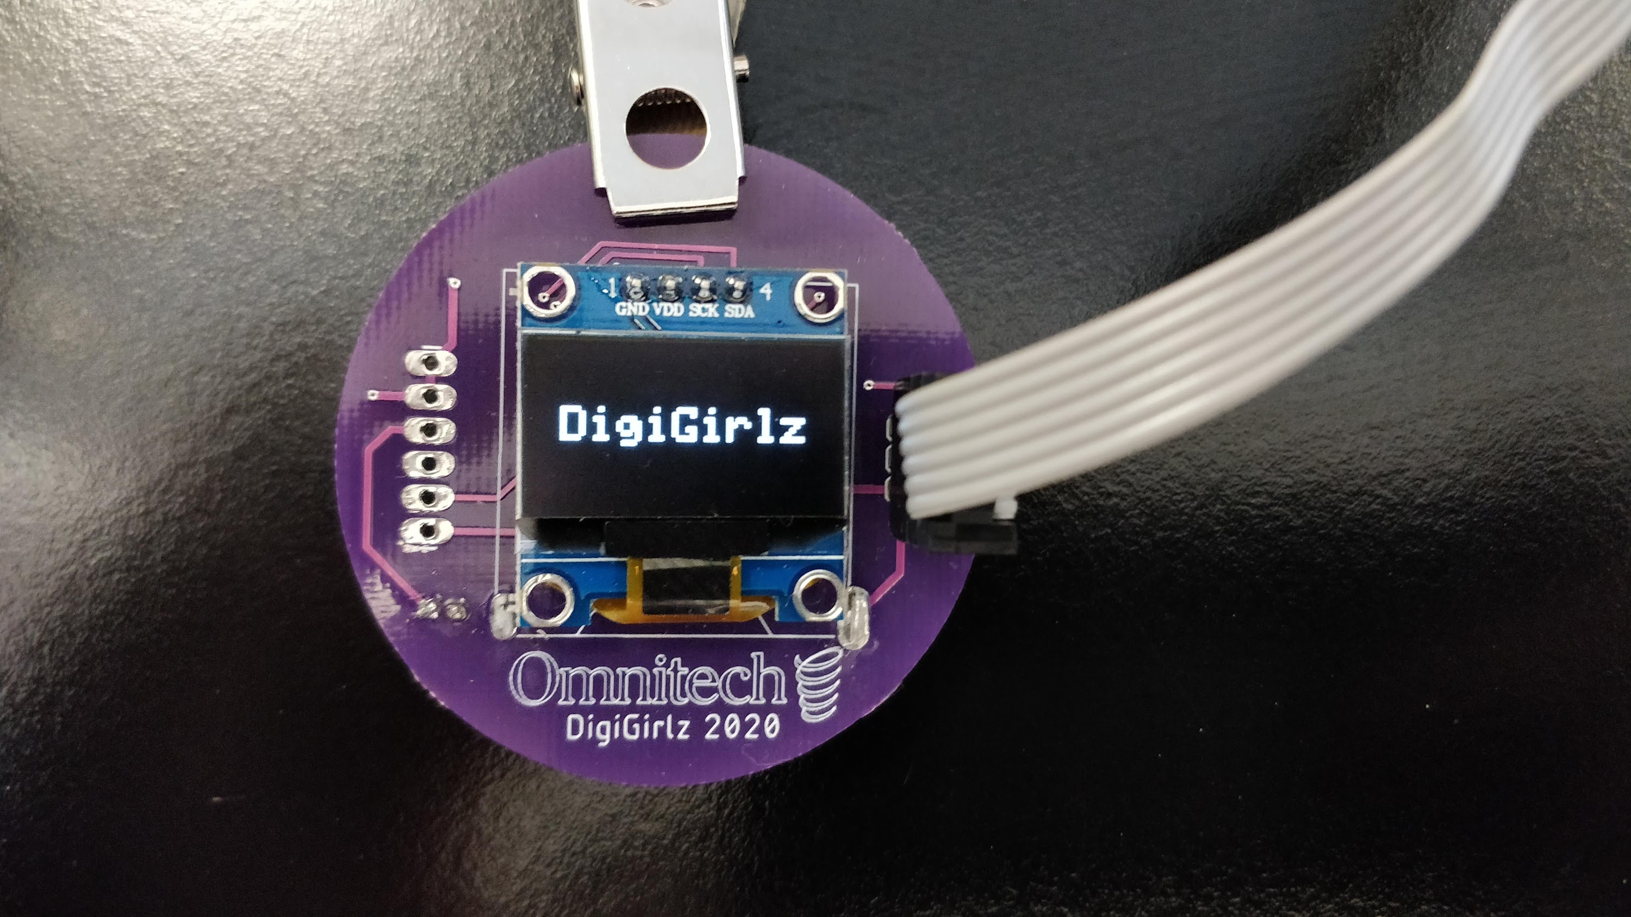
This session
This embedded system is a programmable name badge designed by Omnitech.
In this session, you will learn a bit about the software for this badge and learn how to make it display your name.

Slide 6
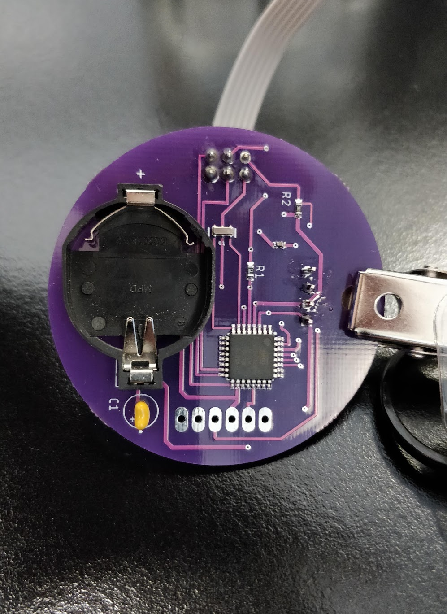
The Badge: An embedded system
The badge only has 8 major components. Most of them are just for regulating power from the battery.
The processor is the square, black component on the back. It is much slower than a normal computer, but works well for small tasks, like this badge.
It only has 0.01% as much memory as a normal laptop computer (2 kB)
It has 0.006% as much storage as a normal laptop (32 kB)
It is overall about 0.5% as fast as modern computers (16 MHz)

Slide 7


Code: How to write software
We’ll be using Arduino, a beginner level tool that uses code similar to the C++ programming language.
You’ll learn how to edit a basic program to make the badge display your name

Slide 8
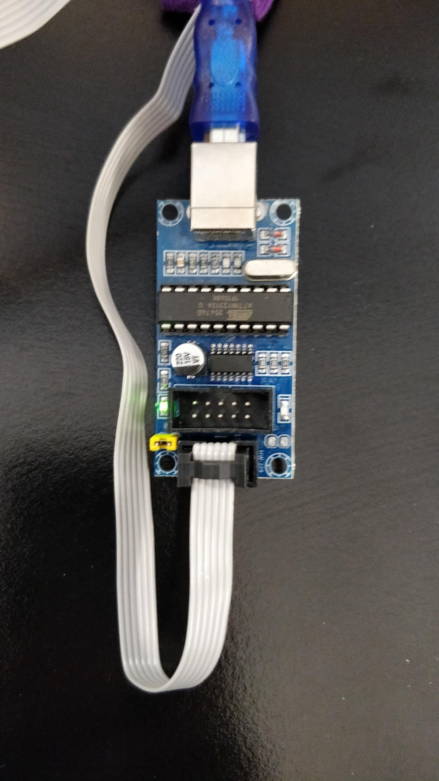
Getting started
Unpack your badge from its bag
Plug the programmer into your computer
Plug the programming cable into the badge as shown on the next slide
The badge should power-on

Slide 9
Breaking down the code
It looks complicated, but it really isn’t!
Software isn’t magic. The computer will do only what we tell it to, but…. It will do exactly what we tell it to do.

Slide 10
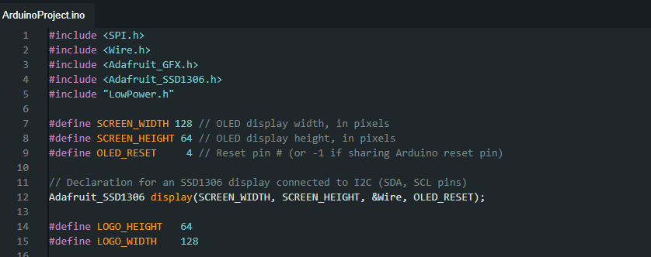
Here we are bringing in some libraries of code that help us do what we want without starting from scratch
We also tell the computer some basic things about this code, like the size of the screen

Slide 11
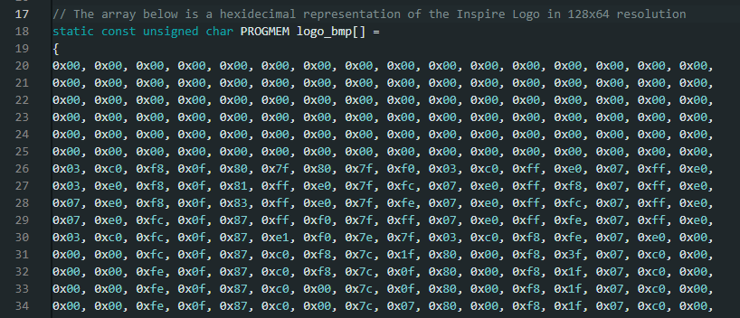
Each item in this grid (0x00) represents a series of eight 1’s or 0’s that tell the screen if we want a pixel to turn on.
Example: 0x01 -> 0000 0001
Remember, we have to tell the computer exactly what we want to do!

Slide 12
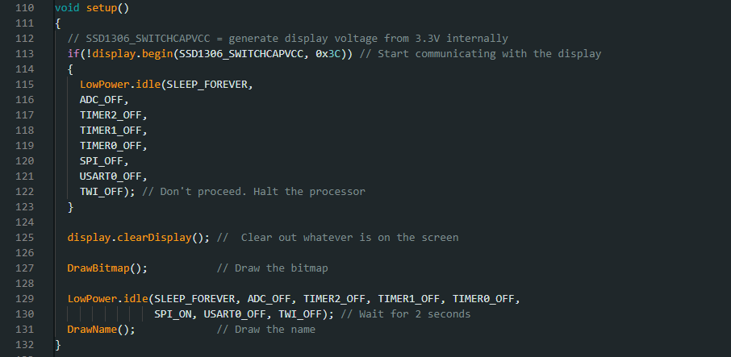

Slide 13
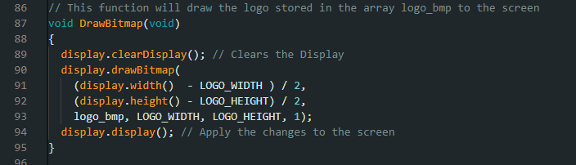

Slide 14
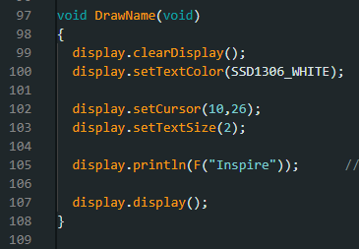
This is where we tell the computer how to write our name

Slide 15
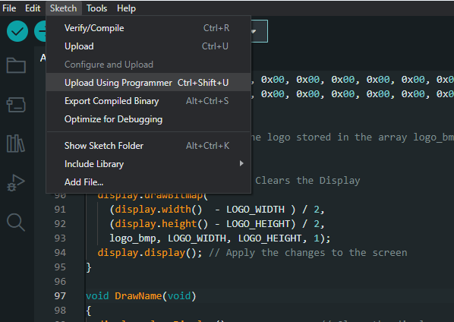

Slide 16
Next steps
Play around with the code. Try and make some changes. Does it do what you thought it would?
Open the Advanced Project and upload it to your board.
Ideas
Change the font size
Move the cursor around
Change some of the numbers in logo_bmp

Slide 17
Resources
You can download everything from today’s session, including this presentation and the advanced project from GitHub.com
https://github.com/aklaudt/iNSPiREBadge
The badge design files are also available online

Slide 18
Careers
If you enjoyed this session, you may enjoy
Computer Engineering
Electric Engineering
Computer Science (Programming)

Slide 19


